Slide 1
Reflection and Refraction

Slide 2
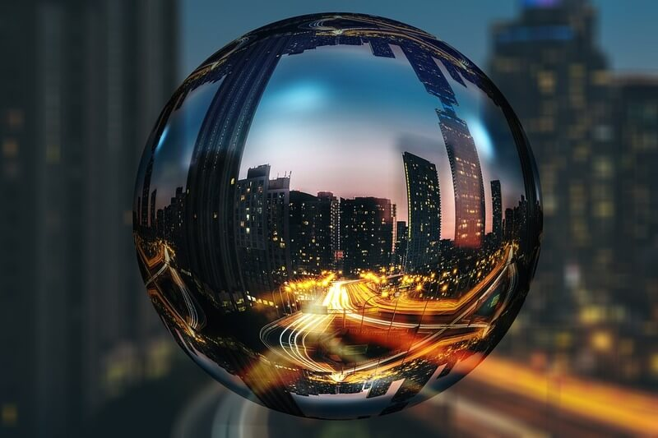
In this Smart Lesson you will learn to:
Define the terms reflection and refraction.
Explain phenomena related to reflection and refraction, using the wave model of light.
Describe the reflection and refraction of a wave at a boundary between two media.

Slide 3
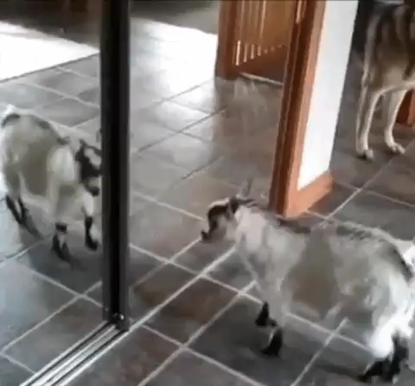
We have all heard of the term reflection.
You see your reflection every day in mirrors, glass and other reflective surfaces.
So what does reflection have to do with waves?

Slide 4
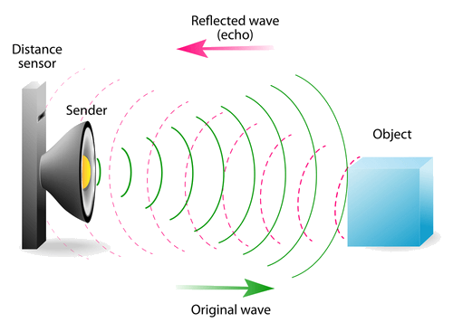
Reflection occurs when waves bounce off a surface.
Reflection is defined as when incident waves at a boundary change direction returning into the same medium according to the law of reflection.

Slide 5
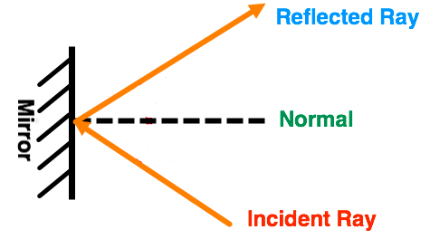
When drawing a wave reflecting off a surface, it is easiest to draw an incident ray to show the direction of the wave.
The wave bounces off the surface and is shown by a reflected ray.

Slide 6
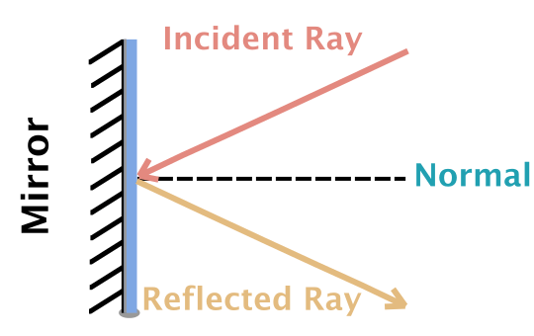
There is another important line called the normal.
This is a line drawn along the point at which the incident ray hits the mirror and reflects away. It is usually used to help draw a reflection diagram.
The normal is always at a right angle (90∘) to the surface of the mirror.

Slide 7
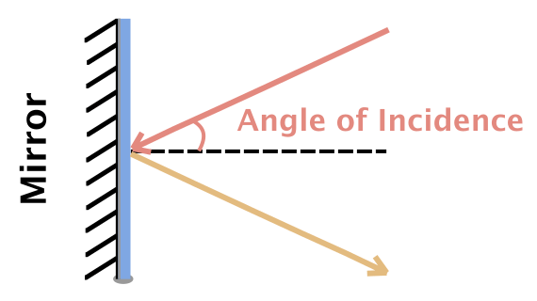
The angle of incidence is the angle between the incident ray and the normal.

Slide 8
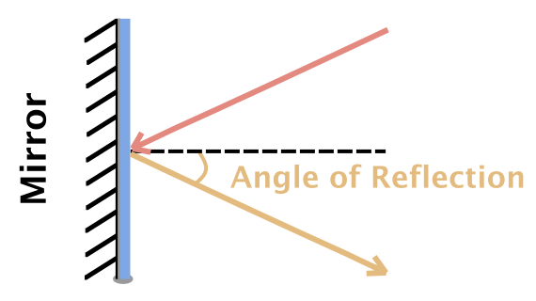
The angle of reflection is the angle between the reflected ray and the normal.

Slide 9
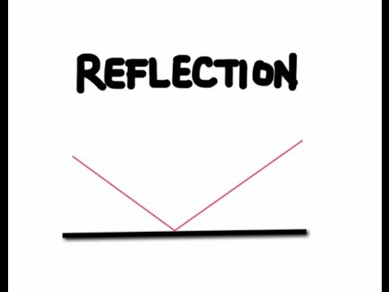

Slide 10
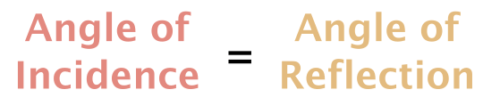
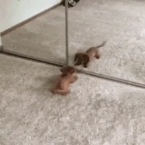
The Law of Reflection states that the angle of reflection is equal to the angle of incidence.
This means that a light ray reflects off a mirror at the same angle that it hits the mirror at.

Slide 11
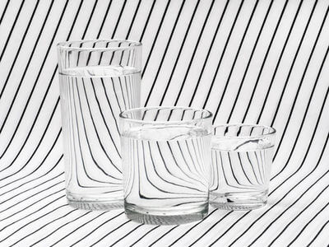
Light is not always reflected from an object - instead, it can sometimes pass through an object.
Objects that allow light to move through them are translucent or transparent.

Slide 12
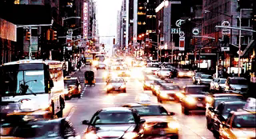
The medium that a light wave is travelling through affects the speed of that light wave.
This is because different media have different densities.

Slide 13
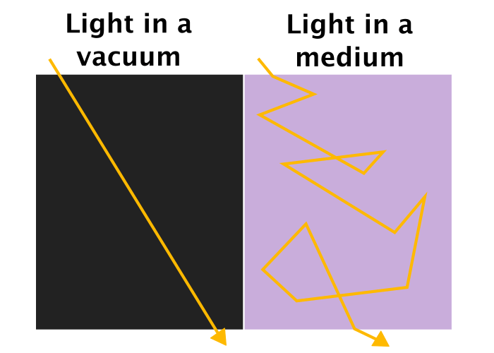
When light moves through a medium, it bounces around between the particles of the medium.
Particles reflect, absorb and redirect light - essentially, light is scattered.
This scattering means that light takes a lot longer to get where it needs to go. Its speed through the medium is slower than the speed of light.
Light travels at light speed between particles, but the scattering means that, overall, it goes slower.

Slide 14
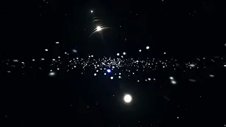
A denser medium has more particles in it.
This causes the light to scatter around the particles and slow down slightly.
A vacuum, like space, has no particles in it. This means that there is nothing to scatter the light and slow it down.
Light travels fastest in a vacuum.

Slide 15
In a vacuum, there are no particles, so light has a straight path from point to point.
This allows it to travel at the speed of light. It is not slowed down by particles getting in the way.

Slide 16

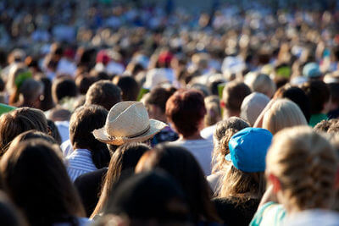
Light passing through a dense medium is like someone trying to run through a densely crowded area.
They still travel at the same speed, but bouncing between people and moving in random directions means that overall they take a lot longer to get through.
VS

Slide 17

Waves travelling at different speeds in different media can have pretty significant effects.
In particular, it causes a phenomenon called refraction to occur.
This is most easily observed by studying light waves.

Slide 18
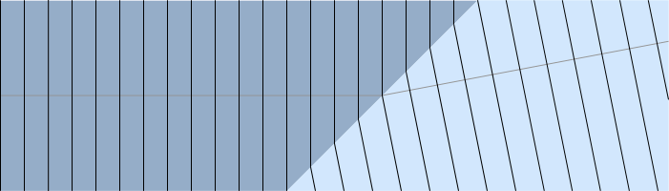
Refraction of waves occurs when the waves pass from one medium into another.
When the wavefront meets the boundary at an angle other than 90∘, there is a change in direction. When the wavefront meets the boundary at a right angle there is no change in direction.
The frequency does not change, but the wavelength and speed of the waves are changed during refraction.

Slide 19
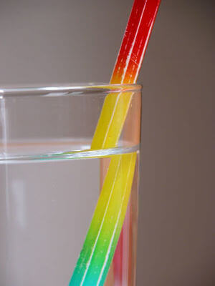
Refraction is seen as a bending of light rays.
It occurs when light travels from one medium into a medium with a different density. We most commonly see this when light travels between air and water. For example, the pencil in the picture to the right looks disjointed. This is due to refraction.

Slide 20
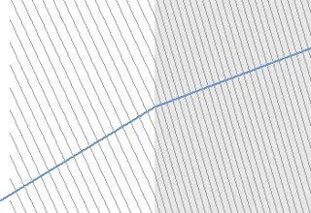
Refraction.
Refraction is defined as when incident waves at a boundary change direction and speed when passing into another medium according to Snell's law of refraction.
This law states that the angle of refraction can be determined from the angle of incidence and the refractive indices of the materials.

Slide 21
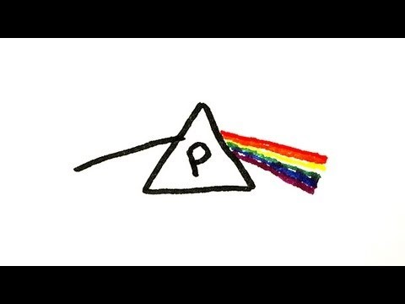

Slide 22
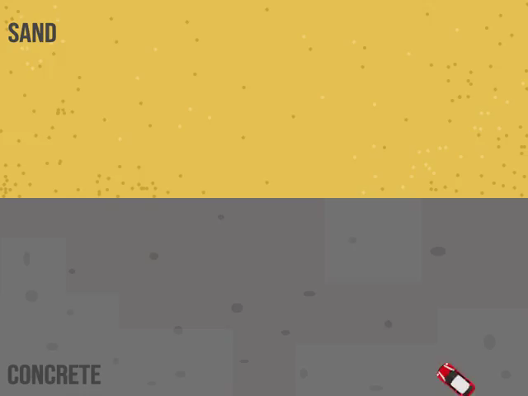
We can use a car to visualise how light rays bend when they are refracted.
Let's imagine a car on concrete driving onto sand (a denser medium) at an angle. The first wheel that touches the sand will slow down, while the other wheels travel at the same speed.
With one wheel going slowly, the car will turn towards the slow wheel. This causes the car to change direction.

Slide 23
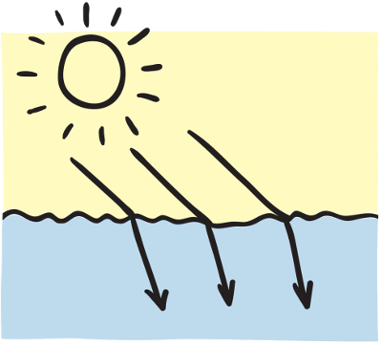
A similar thing happens when light rays travel into a different medium.
When a light ray travels into a denser medium, it will bend.
This is because the light ray travels slower in the new medium.

Slide 24
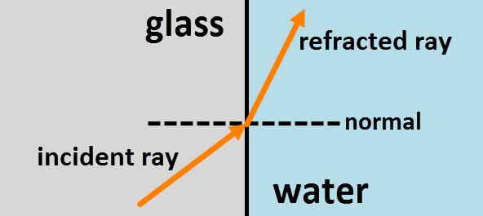
We use ray diagrams to demonstrate how light bends when it passes through different mediums.
The normal is an imaginary line that runs at a 90º angle to the boundary of the media. It is usually represented with a dotted line.

Slide 25
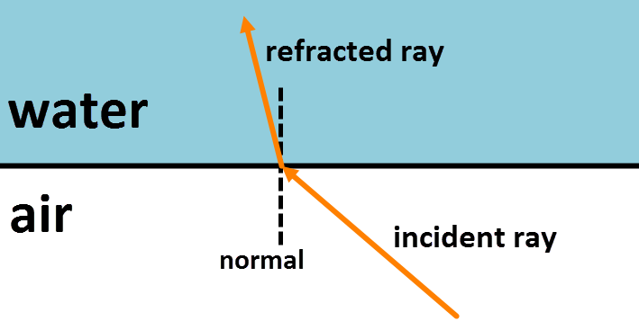
The ray that approaches the place where two mediums meet is called the incident ray.
The ray that leaves is called the refracted ray.

Slide 26
The diagram below shows how the light ray bends towards the normal when it travels from air into water.
This happens because water is denser than air and so the wave slows.

Slide 27
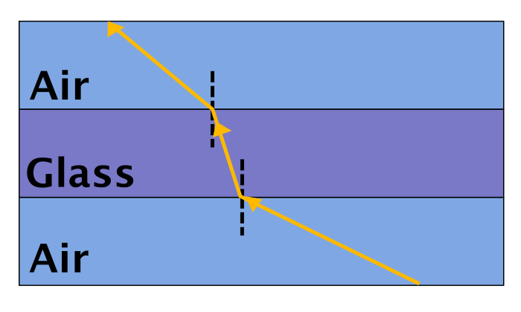
When a light ray travels into a less dense medium, it travels away from the normal.
This is because the ray travels faster in the new medium.
When light travels from air into glass, it bends towards the normal as it slows down. When light leaves the glass and enters air again, the ray bends away from the normal because it can travel faster.

Slide 28
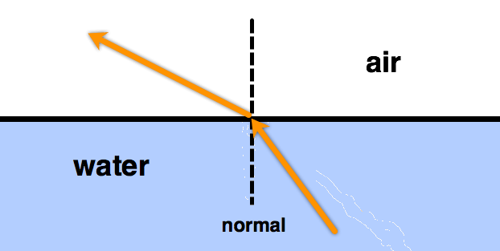
The diagram below shows how a light ray bends away from the normal as it travels from water to air.
This happens because air is less dense than water.

